Slide 1
Loans Data Analysis
Submitted By: Digant Vaibhav Gupta

Slide 2
Case Study 1--Loans data
The dataset contains unsecured loans made to individuals through a third party platform that brings together borrowers and lenders.
The data consists of three separate worksheets in an Excel file:
1. One worksheet with loan data for loans of tenure of 3 years (36 MONTHS)
2. One worksheet with loan data for loans of tenure of 5 years (60 MONTHS)
3. One worksheet containing data with demographic data of borrowers (DEMO)

Slide 3
Data Dictionary for Loans data(3 & 5 year)
Variable | Description
id | A unique LC assigned ID for the loan listing.
member_id | A unique LC assigned Id for the borrower member.
loan_amnt | The listed amount of the loan applied for by the borrower. If at some point in time, the credit department reduces the loan amount, then it will be reflected in this value.
funded_amnt | The total amount committed to that loan at that point in time.
funded_amnt_inv | The total amount committed by investors for that loan at that point in time.
int_rate | Interest Rate on the loan
installment | The monthly payment owed by the borrower if the loan originates.
grade | LC assigned loan grade
sub_grade | LC assigned loan subgrade
is_inc_v | Indicates if income was verified by LC, not verified, or if the income source was verified
accept_d | The date which the borrower accepted the offer
issue_d | The month which the loan was funded
loan_status | Current status of the loan

Slide 4
Data Dictionary for DEMO dataset
Variable | Description
id | A unique LC assigned ID for the loan listing.
emp_name | Employer Name
emp_length | Employment length in years. Possible values are between 0 and 10 where 0 means less than one year and 10 means ten or more years.
home_ownership | The home ownership status provided by the borrower during registration. Our values are: RENT, OWN, MORTGAGE, OTHER.
annual_inc | The annual income provided by the borrower during registration.
desc | Loan description provided by the borrower
purpose | A category provided by the borrower for the loan request.
title | The loan title provided by the borrower
addr_city | The city provided by the borrower in the loan application
addr_state | The state provided by the borrower in the loan application

Slide 5
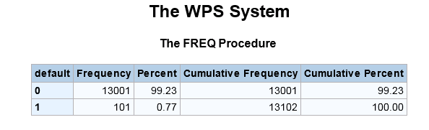
Q1) What is the total default rate?
Assumptions:
- Considering the Loan_Status value as Default or Late(31-120) as a definition of defaults.
- Final result of default rate would be taken out from the combined set of 36 month loans and 60 month loans.
Answer: Default rate : 0.77%

Slide 6
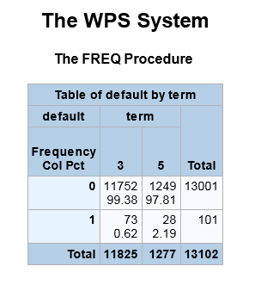
Q2) Is there a big difference in defaults between 3year and 5 year loans.(>3%)
Answer:
3 year term default % → 0.62%
5 year term default% → 2.19%
Clearly difference between Default % is less than 3%
Hence no big difference

Slide 7
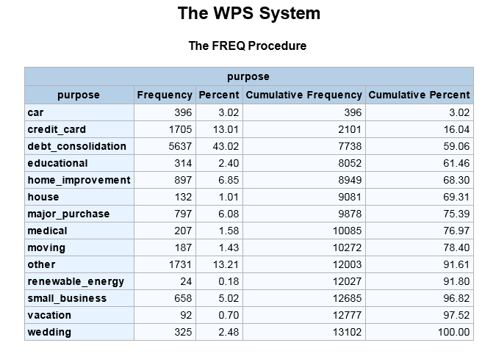
Q3)Most common reason cited for taking loan.
Answer:
Debt Consolidation
43.02%

Slide 8

Q4) What is the ratio of loan requested to income?
Answer: The required ratio is 0.178

Slide 9

Q5) What is the average grant rate?
Answer: The average grant rate is 1.028.

Slide 10
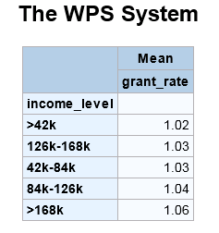
Q6) How does the average grant rate differ by income levels
Answer:
The average grant rate uniformly
increases as the income level
increases except for the
interval 126k-168k.

Slide 11
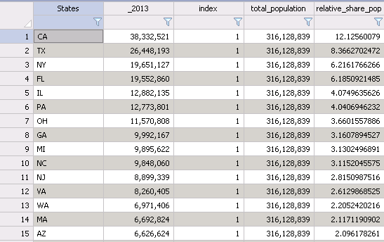
Q7) a) Which states are overpopulated?
Answer: Table showing top 15 overpopulated states among which the top 3 are
CA, TX and NY

Slide 12
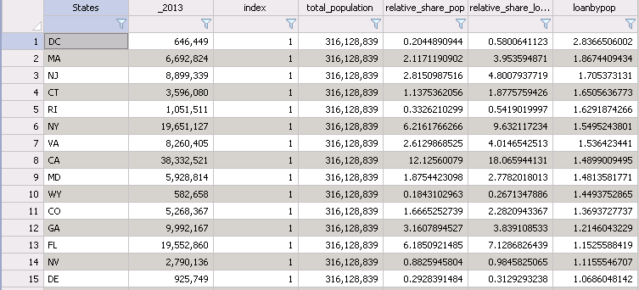
Q7) b)Which states have a larger relative share of loans as compared to population share
Answer : The table showing top 15 states whose relative share of loans are much higher than expected based on relative share of population.
TOP 3 : DC, MA and NJ

Slide 13
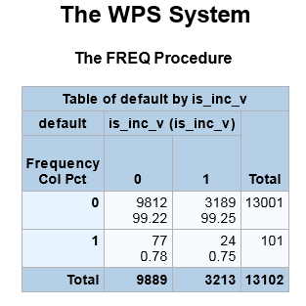
Q8). How important is income verification for granting a loan?
We see that when the income verification was done the default was 0.75% and when the verification was not done it was 0.78%.
Thus we see an decrease of 4%
in default rate if we move from
non-verification to verification.
Verification is significantly important in
reducing the default rates.

Slide 14
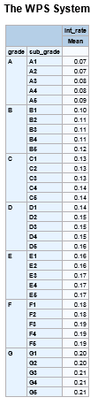
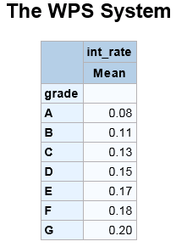
Q9) What is the average interest rate by grade and sub-grade?
Answer: The table displays average interest
rate by grades and sub-grades.

Slide 15

Q10. What is the average time between loan acceptance date and loan issuance date?
Answer: The average time is 9 days.

Slide 16
Q11. Are there any customers that loan data is available for but not demographic data and vice versa?
Answer : No there are no customers which are present in loan data and not in demo data and vice versa.

Slide 17
Q12) Key insights from the data
Top reasons cited for taking loan
Grant rate dependency upon income verification
Grant rate dependency upon employment length
Grant rate dependency upon salary range and ownership type
Default rate dependency upon ownership type
Default rate dependency upon installment value

Slide 18
Most common cited reason for taking loan
Clearly the top two reason are :-
Debt Consolidation (43%)
Credit Card (13%)

Slide 19
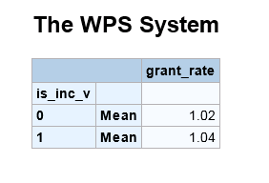
Grant Rate V/S Is_Inc_V
From the table it is clearly seen that the customers who have got their income verification done are more likely to get a higher loan amount as compared to the amount that they requested for.
This also essentially holds true as income verification done people are less risky and so more loan can be given to them as verification has proved their credit-worthiness.

Slide 20
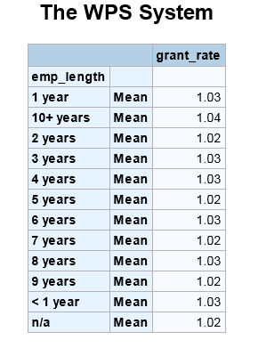
Grant Rate V/S Employment Years
From the table it is clearly seen that people
who are having employment length of more
than 10 years are enjoying the maximum grant
rate .
Clearly these people are loyal to the company
and are less probable to default on the payments

Slide 21
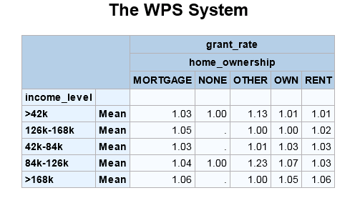
Grant Rate V/S Income Value
As we can see in the dataset that grant rate
increases as the income level increases ,
Specially for those customers who have home
ownership type as mortgages.
Mortgaged properties are a good way to
assess the credit worthiness of the client.
It provides accurate information about the
payments history and CIBIL score of the customer

Slide 22
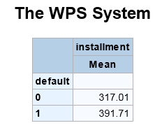
Default Rate V/S Installment Value
Those customers who have a higher value of installments are more likely to default on the payments as compared to those people who have a lesser amount of installments.

Slide 23
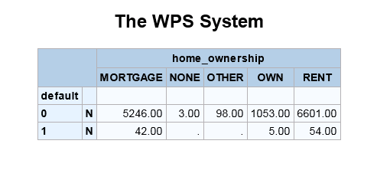
Default Rate V/S Home Ownership
It is clearly seen from the table that people who own mortgaged properties and live on rented properties are more likely to default on the payments(1%) as compared to those who are having their own properties.
Mortgage property Default rate – 80%
Rent property Default rate -- 82%
Own property Default rate – 47.5%

Slide 24
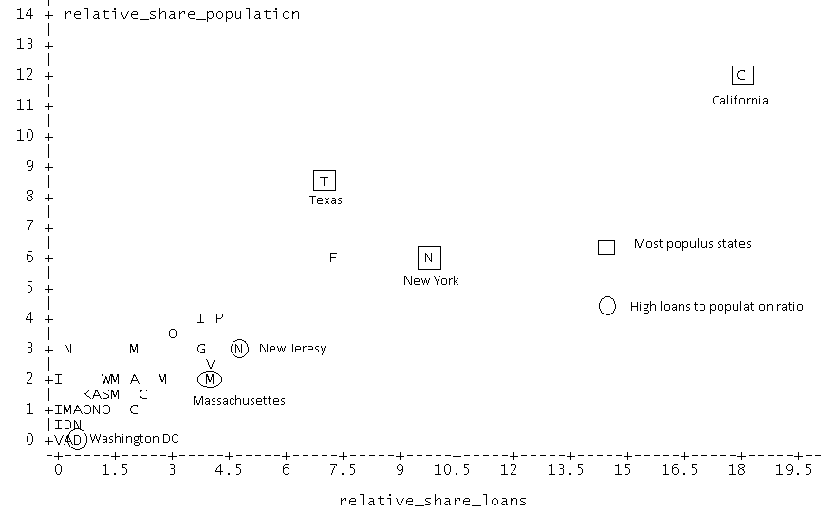
US -Relative Loans to relative population

Slide 25
THANKS A LOT

